Slide 1
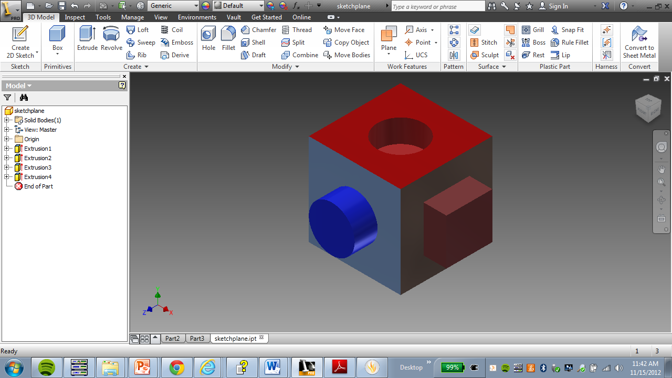
Sketch plane cube
SciTech/Mr. Pozzi

Slide 2
Now we are going to start messing around with what inventor can really do.
Open inventor
Open a new document
Open a standard .ipt
First shape – 2”x 2” x 2” cube.
Click on create 2D sketch
Click on your xy – plane – front
Use your rectangle tool
Dimension the rectangle to 2” by 2”. (see picture)
Click on the green check that says finish sketch.
Click on extrude
Extrude your shape to 2” (see picture)
Press enter.

Slide 3
First addition – 1 inch radius circle
Right click On the front of your shape. (see picture)
Select new sketch from the menu that pops up.
Now select the circle tool from the drawing menu.
You will need to dimension the following things:
  Click on the center of the circle and the side. Enter 1”.
  Click on the center of the circle and the bottom. Enter 1”.
  Click on the edge of the circle and then click outside the circle. Make the radius 1”. (see picture)
Click Finish Sketch.

Slide 4
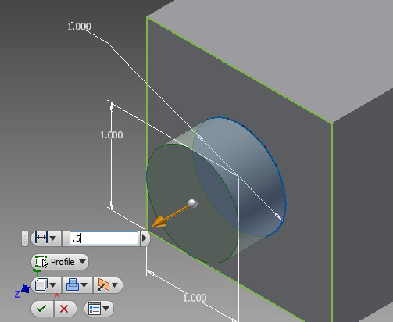
First addition – extrusion
Click extrude
Select your circle by clicking on it.
Enter .5” in your input box.
Press enter.

Slide 5
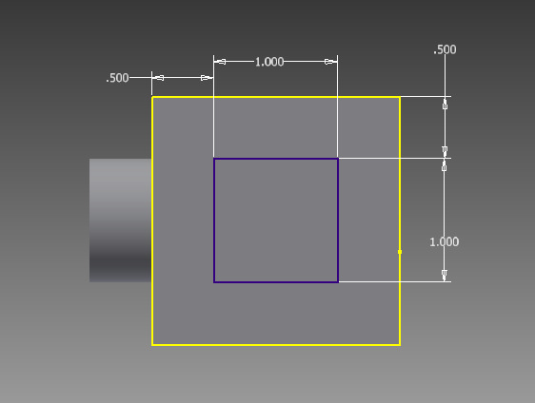
Second addition– 1 inch square
Right click On the side of your shape.
Select new sketch from the menu that pops up.
Now select the rectangle from the drawing menu.
Draw a rectangle inside your square.
You will need to dimension the following things:
  Click on the side edge of the smaller square and the side edge of the big square. Enter 0.5”
  Do the same for the top edge.
  Make your square 1” by 1”
  (see picture)
Click Finish Sketch.

Slide 6
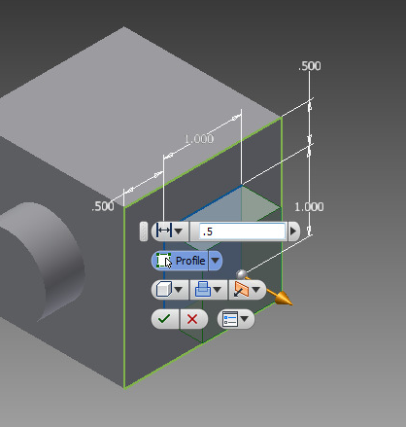
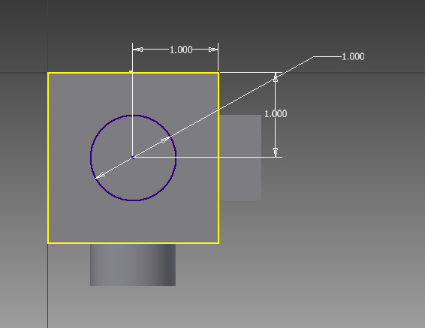
second addition – extrusion
Click extrude
Select your rectangle by clicking on it.
Enter .5” in your input box.
Press enter.
First reduction – 1 inch circle
Right click On the top of your shape.
Select new sketch from the menu that pops up.
Now select the circle from the drawing menu.
Draw a circle inside your square.
Fill in the same dimensions as before.
  (see picture)
Click Finish Sketch.

Slide 7
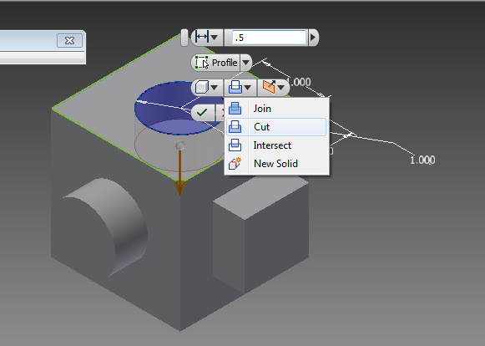
First reduction– extrusion
Click extrude
Select your circle by clicking on it.
See the drop down menu in the picture. Select cut.
Enter .5” in your input box.
Press enter.
Add some textures and colors so we can see what is going on.
You’re done. Save as sketch plane.
Print. This is your last piece of your portfolio.
Good job.

